Slide 1
COMPUTER NETWORKS PROJECT · FIRST REVIEW
NetTwin-SDN
Telemetry-Guided Self-Healing Campus Network Architecture
TEAM
GUIDANCE
Namit Gupta
Abdullah Aijaz
Aarnav Bahadur Mathur
Usman Gani Ahmad
Dr. Sudha M, Professor
First Review, 15 September 2026

Slide 2
THE PROBLEM
Networks today wait for things to break
Reactive by default: a link or server has to fail completely before anyone finds out.
Detection is manual: someone usually notices only after a user complains it “isn’t responding.”
Doesn’t scale: more clients means every extra minute of downtime costs more.
No quick diagnosis: a bad cable, an overloaded switch and a crashed server all look the same from far away.
NetTwin-SDN
02

Slide 3
OBJECTIVES
What this project sets out to do
Build a small virtual campus network in Mininet, with a backup path between hosts.
Detect both kinds of failure: a dead link or device, and a server that stops responding while the link stays fine.
Heal automatically: reroute traffic to a working path the moment a failure is found, with minimum delay.
Prove it: measure recovery time before and after, and keep the whole build free and software-only.
NetTwin-SDN
03

Slide 4
LITERATURE REVIEW
Grounded in existing SDN practice
Control plane vs. data plane: SDN separates decision making from packet forwarding, which is the core idea the whole project is built on.
OpenFlow: the protocol used to program switches, including Fast Failover Groups that keep a backup path ready in advance.
A digital twin approach: the controller keeps a continuously updated picture of link and server health and reacts to it in real time, instead of polling on a fixed schedule.
Fault localisation beyond the link: watching link status alone misses a server that has crashed while the link stays up, so this project adds a server level health check on top of standard OpenFlow monitoring.
NetTwin-SDN
04

Slide 5
HOW THE PIECES TALK
Northbound and southbound APIs
Northbound API: sits between the controller and applications, usually a simple REST interface.
In this project: the health-check logic and any dashboard talk to the controller through this side.
Southbound API: sits between the controller and the switches, with OpenFlow as the standard example.
Why it matters: keeping both sides separate lets switches or controller logic change without breaking the other.
NetTwin-SDN
05

Slide 6
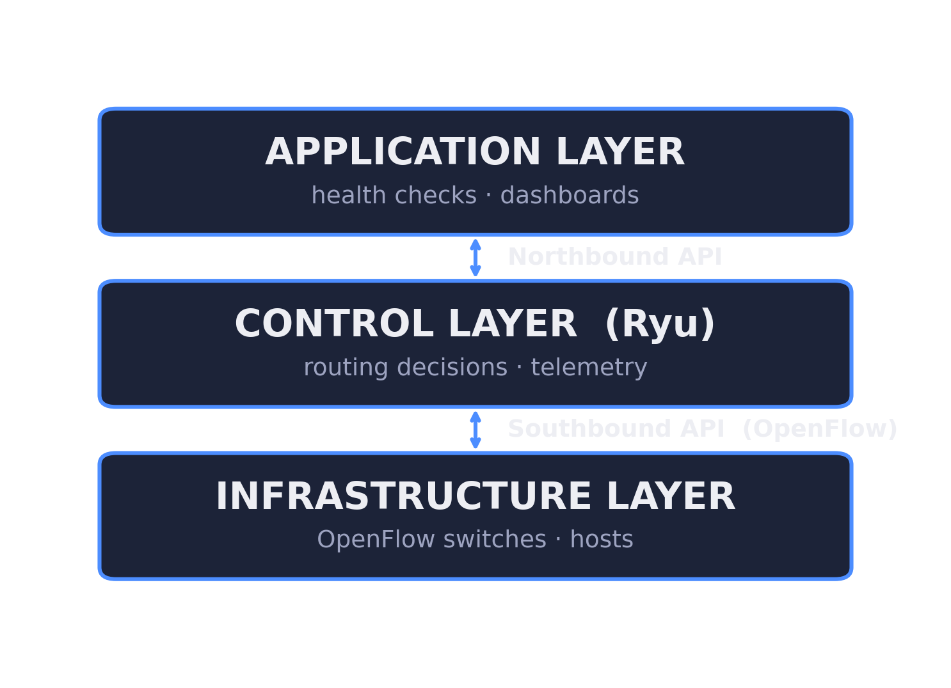
SYSTEM ARCHITECTURE
Three layers, cleanly separated
NetTwin-SDN
06

Slide 7
PROPOSED METHODOLOGY
From topology to automatic healing
1. Topology: Mininet builds the campus network with switches, clients, servers, and a backup link.
2. Health monitoring: Ryu watches OpenFlow port stats for the link, and sends heartbeats to the server.
3. Fault localisation: the error pattern tells the controller if it’s a cable, a switch, or the server itself.
4. Automatic healing: traffic flips to a pre-installed backup path, and the switch acts on it instantly, without waiting on the controller.
NetTwin-SDN
07

Slide 8
DEMONSTRATION PLAN
How we’ll show it working
Break it on purpose: kill a link or a host live, during the demo.
Capture it: Wireshark records the traffic before, during, and after the failure.
Measure it: a before-and-after graph shows exactly how fast recovery happens.
Show the logic: walk through how the controller decided what failed and where.
NetTwin-SDN
08

Slide 9
TOOLS & ENVIRONMENT
Free, open source, one laptop
Mininet and Open vSwitch: Mininet builds the virtual hosts, links, and topology; Open vSwitch supplies the actual OpenFlow-compliant switches inside it.
Ryu controller (Python): installs the OpenFlow forwarding and failover rules on the switches, and runs the server health checks.
Flask (Python): runs the small HTTP server under test on a Mininet host; it can be killed on demand to simulate a crash.
Wireshark and Matplotlib: Wireshark captures the failover traffic as proof; Matplotlib plots the before and after recovery time graphs.
NetTwin-SDN
09

Slide 10
WORK PLAN
On track for the final review
Done: topology finalised, Mininet + Ryu installed, basic connectivity confirmed.
Next: link-failure detection via OpenFlow port statistics.
Then: server health checks, fault localisation, and automatic rerouting.
Final week: collect performance data, build graphs, and write up results, ready for October’s review.
NetTwin-SDN
10

Slide 11
Thank You
Questions & discussion

